Slide 1
Long Essay Question (LEQ)
By Jeff Anderson

Slide 2
Long Essay Question
Section II, Part B of the AP Exam consists of a choice among three long essay questions from different time spans of the course.
QUESTION 1 – 1200-1750
QUESTION 2 – 1450-1900
QUESTION 3 – 1750-2001
The three question options all address the same Theme and assess the same Historical Thinking Skill (all causation, all comparison, etc.)

Slide 3
Themes
Theme 1: Interaction Between Humans and the Environment
Theme 2: Development and Interaction of Cultures
Theme 3: State Building, Expansion, and Conflict
Theme 4: Creation, Expansion, and Interaction of Economic Systems
Theme 5: Development and Transformation of Social Structures 28

Slide 4
Historical Thinking Skills
Compare / Contrast
Cause / Effect
Change and Continuity Over Time (CCOT)

Slide 5
Comparison (Compare / Contrast)
Describe similarities and/ or differences between different historical developments or processes.
Explain relevant similarities and/or differences between specific historical developments and processes.
Explain the relative historical significance of similarities and/or differences between different historical developments or processes.

Slide 6
A
B
were similar in the way that they…
A
B
were different in the way that they…

Slide 7
Causation (Causes and/or Effects)
Describe causes or effects of a specific historical development or process.
Explain the relationship between causes and effects of a specific historical development or process. Explain the difference between primary and secondary causes and between short- and long-term effects.
Explain the relative historical significance of different causes and/or effects.

Slide 8
Causes
Effects
A
Event
Event
A
B
B
C
C
Causes AND Effects
A
Event
A
B
B
C
C

Slide 9
Continuity and Change Over Time (CCOT)
Describe patterns of continuity and/or change over time.
Explain patterns of continuity and/or change over time.
Explain the relative historical significance of specific historical developments in relation to a larger pattern of continuity and/or change.

Slide 10
Snap Shot A
Snap Shot B
Changes
Continuities

Slide 11
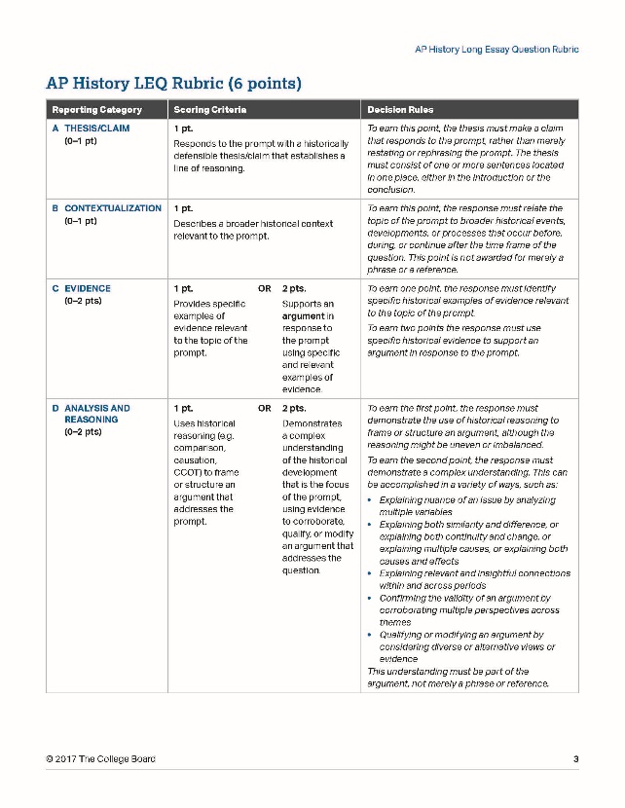
Rubric

Slide 12
Intro Paragraph
Contextualization
Thesis

Slide 13
Contextualization
Much like the DBQ, your intro paragraph will start with “Setting the Stage”
Where does the topic of the information fit into World History?
What was going on in the world before, during, or after this event/topic?
Brainstorm specific people, events, places, etc.

Slide 14
Thesis (Format)
Thesis statement MUST address HTS in the question
Must take a stand…make a claim…something that can be argued
Provide specifics (evidence) that directly answer the question
You may think generally (SPRITE categories), but try to pull out something specific you can name
1-2 sentences

Slide 15
Thesis
Use all information given (time period, region, etc.)
Use TWO topics to answer question
You may want to mention the counterpoint here to introduce complexity
Example:
LEQ is looking at HTS of effects
Name your TWO effects AND mention ONE cause
Heimler formula:
Despite [counterargument], because [evidence 1] and [evidence 2], [my argument].

Slide 16
Thesis (continued)
Comparison
Although Topic A and Topic B are different in the way that they ___________, they are similar in [evidence 1] and [evidence 2]
Causation
Although trade in Region A and Region B impacted the world with ___________, they caused trade to flourish by using {evidence A] and [evidence B].
Continuity and Change Over Time
Although the overall governmental structure did not change in _______, political changes occurred from Snap Shot A to Snap Shot B in the areas of [evidence A] and [evidence B].

Slide 17
Body Paragraphs
Topic Sentence can be the same as your [evidence A] and [evidence B]
State similarity/difference, cause/effect, or change/continuity
What was it specifically
Demonstrate this with at least TWO supporting details per paragraph
Use historical figures, places, events, facts, etc. (BE SPECIFIC)
NAME IT
DEFINE IT
EXPLAIN IT
“Due to,” “Because of,” “The reason for,” etc.

Slide 18
Conclusion
Not on Rubric
This is your second chance to get your Thesis point!
Restate your thesis in different terminology
DON’T REWRITE THE SAME THING!!!
If you missed it once, you’ll miss it again this way
Reverse engineer your intro paragraph
You also get a second chance at Contextualization here!

